Slide 1
A Virtual Cluster Manager using a Hierarchical Model for Cloud Infrastructure
Pongsakorn U-chupala
Kasetsart University
Notes:
Thank you, MC. My name is Pongsakorn U-chupala. From Kasetsart University, Thailand. I’d like to talk about our project, A Virtual Cluster Manager using Hierarchical Model for Cloud Infrastructure

Slide 2
Outline
Introduction
Virtual Machine
Virtual Infrastructure (Cloud Infrastructure)
Virtual Cluster
Problems
Proposal
Virtual Cluster Manager
Evaluation
Case Study
Conclusion
Notes:
This talk is divided into 3 sections
First, the introduction, I’ll explain some basic knowledge and the problem we’re trying to solve.
Second, Virtual Cluster Manager, our proposed solution to the problem
Lastly, Case Study on our proposed solution compare to existing method

Slide 3
1. Introduction
Notes:
Let’s start from the introduction

Slide 4

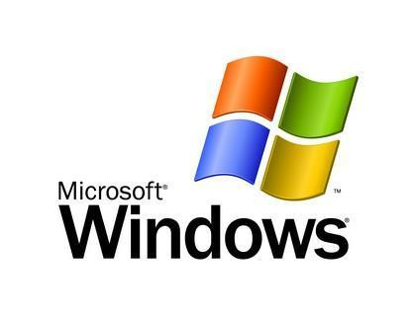
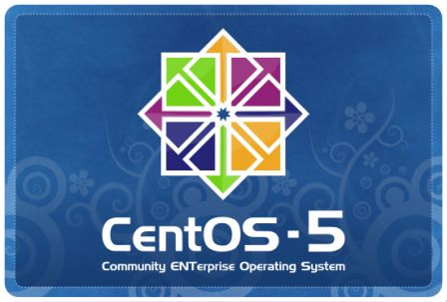




Virtual Machine (VM)
Computer
Notes:
But we only have one machine? What should we do?
----- Meeting Notes (1/20/12 16:54) -----
Reduce it here

Slide 5
Virtual Machine (VM)
Computer
Isolated Environment
Notes:
Well, with the technology called “Virtual Machine”
Virtual Machine is a technology to create a virtual computer inside a physical, real computer.
We could also create multiple virtual machine inside single physical machine. Each virtual machine could have separated environment for each user.
Regular user will find no different between real machine and virtual machine.
----- Meeting Notes (1/20/12 16:54) -----
Now VM technology such as … allow ppl to use different os on top of single machine like this
vm tech such as ...
assume we have 1 win, thanks to VM, we can use Linux, Mac on top…
*MODIFY THIS FIGURE

Slide 6
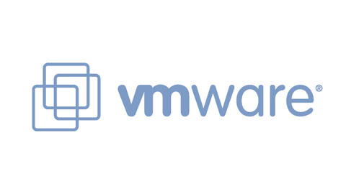



Virtual Machine Software

Slide 7


Virtual Infrastructure (VI)
Administrator
Virtual Infrastructure
Manually configure/manage
each physical machine
Notes:
With VM technology, Let’s say this time, we have a lot of physical machine, each machine also contain a lot of virtual machine. For administrator to manage all of this manually is a very tedious task.
Luckily, we have a technology call Virtual Infrastructure which generalize virtual machine management on a set of physical machine. From administrator perspective, he’ll only need to manage a single large infrastructure instead of separated physical machine.
----- Meeting Notes (1/20/12 16:54) -----
*title background of VI
explain social reason, social background. who is admin?
right now, admin has much diffuculty on management...
add user in the figure
change color and some explanation text

Slide 8



VI Software
Notes:
----- Meeting Notes (1/20/12 16:54) -----
combine back...

Slide 9
Virtual Cluster (VC)
VI
Single VM have limited capability, not enough intensive use
Computational power
Storage
One powerful VM isn’t easily scalable in the long run
User could have multiple VM but they need to be configured to work together
?
User
Notes:
Having more computers doesn’t make you more productive unless they are properly configured to work together.
----- Meeting Notes (1/20/12 16:54) -----
so far ppl just want to use single machine but right now, according to the computational demand, ppl want to use multiple vm as vc
ppl want to use multiple vm as a single system, VI can't satisfy this reqs
use social background
title: demand for VC

Slide 10
Virtual Cluster (VC)
Worker 0
Worker 1
Worker 2
Storage 0
Storage 1
Worker Network
Storage Network
Master
Internet
Notes:
With those technologies, It become easy to provide a single virtual machine to user. However, sometime, user need more than 1 VM.
Let’s say we need to provide a number of VM. Each machine have some kind of relationship among one another. We call this set of VM, Virtual Cluster.
It’s not a single VM anymore, It’s a cluster of VM.
----- Meeting Notes (1/20/12 16:54) -----
dificulty setting this up
i.e. shared storage,
slide more than i talk.
such work is require for each user, that why admin work is increasing even with VI
what is admin work?

Slide 11
Problem
Virtual Infrastructure
Virtual Infrastructure allows management of each VM as an individual unit
Deploying a set of VMs and link them together to make a VC need to be done manually
Notes:
----- Meeting Notes (1/20/12 16:54) -----
admin has a lot of difficulty in setting VC for *each* user

Slide 12

Problem
Worker 2
Master
Storage Network
Worker Network
Worker 0
Administrator
Worker 1
Storage 0
Storage 1
Internet

Slide 13
Problem
Virtual Infrastructure allows creation/management of each virtual machine as a single unit
Deploying a set of virtual machines and link them together to make a virtual cluster need to be done manually
VM in a VC could span into thousands of machines
Manually maintaining each VM manually is a tedious tasks
Notes:
The problem is…
With VI technology, it’s allow .. as a single, individual unit.

Slide 14
Goal
Make VC management simpler, easier for administrator

Slide 15
2. Proposal
Notes:
Our propose solution to this problem is a Virtual Cluster Manager
----- Meeting Notes (1/20/12 16:54) -----
Top down approach

Slide 16

Current Solution
Create/Consult
Documentation
VM Relationships
VM Dependencies
VM Template
VM Template
VM Templates
Virtual Infrastructure
Virtual Infrastructure Manager
Existing VI
management scheme

Slide 17
Proposed Solution
VM Template
VM Template
Virtual Cluster Template Set
VM Templates
Documentation
VM Relationships
VM Dependencies

Slide 18
Proposed Solution
Virtual Cluster Template Set
Virtual Infrastructure
VI Manager
VC Manager
Notes:
----- Meeting Notes (1/20/12 16:54) -----
extend vm template to vc
explain the effort
use top down approach

Slide 19
Virtual Cluster Manager
A utility for virtual cluster management
Single point of operation for deployment, stop/suspension, deletion and monitoring VC
Work in coordination with existing virtual infrastructure management scheme
Understand complexion of virtual cluster
Relationships between VM in a VC
Dependencies between VM in a VC

Slide 20
Virtual Cluster Manager
A utility for virtual cluster management
Single point of operation for deployment, stop/suspension, deletion and monitoring VC
Work in coordination with existing virtual infrastructure management scheme
Understand complexion of virtual cluster
Relationships between VM in a VC
Dependencies between VM in a VC
Notes:
The first 2 point is pretty straightforward. The hard part is to make a system that understand “Relationship” and “Dependencies” within a virtual cluster.
----- Meeting Notes (1/20/12 16:54) -----
use general/high level information
----- Meeting Notes (1/20/12 17:24) -----
explain relationship and dependencies to show difficulty, skip the model explanation, how i solve it

Slide 21
VC Hierarchical Model
A model to represent virtual cluster
Divided into 2 hierarchies
Structural hierarchy ⬅ Relationships
Group similar VMs together
Dependency Hierarchy ⬅ Dependencies
Used to determine order of VM in which operation will be performed to
Notes:
Group VM with similar characteristic/role together
----- Meeting Notes (1/20/12 16:54) -----
because of time restriction, i'll explain 1 hierarchy
in order to make this point, i spent much effort on this model but because of time restriction is...
dependencies <-> relationship the different is not clear
relationship is too general

Slide 22
VC Hierarchical Model
A model to represent virtual cluster
Each VM in a cluster need to be grouped/ranked into a certain hierarchy
Divided into 2 hierarchies
Structural hierarchy ⬅ Relationships
Group similar VMs together
Dependency Hierarchy ⬅ Dependencies
Used to determine order of VM in which operation will be performed to
Notes:
Group VM with similar characteristic/role together

Slide 23
1. Structural Hierarchy
Virtual Cluster
VM Type
Virtual Machine
VM Type
Virtual Machine
Virtual Machine
VM Type
Virtual Machine
Virtual Machine
Notes:
Just show and skip
----- Meeting Notes (1/20/12 16:54) -----
show simple slide that reflect relationship and dependencies instead

Slide 24
2. Dependency Hierarchy
VM Type 0
VM Type 2
VM Type 1
VM Type 3
VM Type 4
Notes:
Just show and skip

Slide 25
Example VC
Master 0
Worker 0
Worker 1
Worker 2
Notes:
Just show and skip

Slide 26
Example VC
My Virtual Cluster
VM Type: Master
VM Type: Worker
Master 0
Worker 0
Worker 1
Worker 2

Slide 27
3. Evaluation

Slide 28
Case Study
We have implemented a VC manager with described design using OpenNebula (VI) as a building block
Then did a case study with
OpenNebula-provided utilities (default management scheme)
Our implemented VC manager
Point of interest: Ease of Use

Slide 29
Ease of Use
Deploy an example virtual cluster
Assumption: The lesser the size of input there is, the easier it become
Measure “ease of use” with number of commands and template files, which represent a size of input, used to deploy a virtual cluster
Notes:
The lesser the size of input it is, the easier it become. Of course, result of the input must stay the same.

Slide 30
Example VC
Master 0
Worker 0
Worker 1
Worker 2

Slide 31
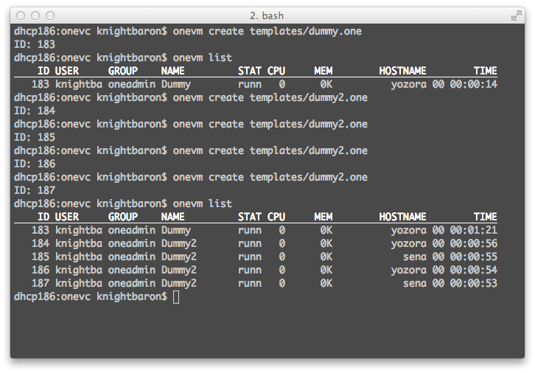
Commands

Slide 32
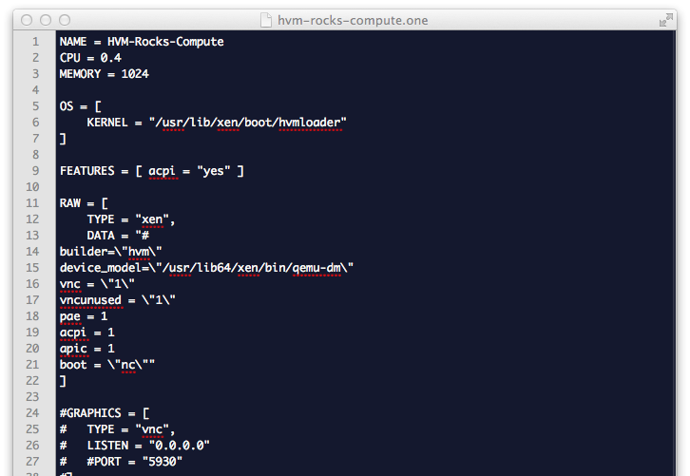
Template Files

Slide 33
Results
Default Scheme
VC Manager
2 template files used
3+n commands used
n is a number of worker
3 templates file used
2 commands used
Although VC manager requires 1 more template, a number of commands used is a lot less than using default management scheme especially at higher number of worker
Notes:
----- Meeting Notes (1/20/12 16:59) -----
draw a graph

Slide 34
Template File Used

Slide 35
4. Conclusion

Slide 36
Conclusion
“VC manager” is our approach to simplify virtual cluster management for administrator
VC Hierarchical model is developed to describe VC and its complexion to the manager
Case study we did show that our approach is better the current management scheme

Slide 37
Publication
The paper on this work was published in the proceeding of the 6th International Conference on Ubiquitous Information Technologies & Applications at Seoul, Korea on December 15-17, 2011

Slide 38
I’d like to thank…
ShimojoLab @ Cybermedia Center
Osaka University
Japan Student Services Organization (JASSO)

Slide 39
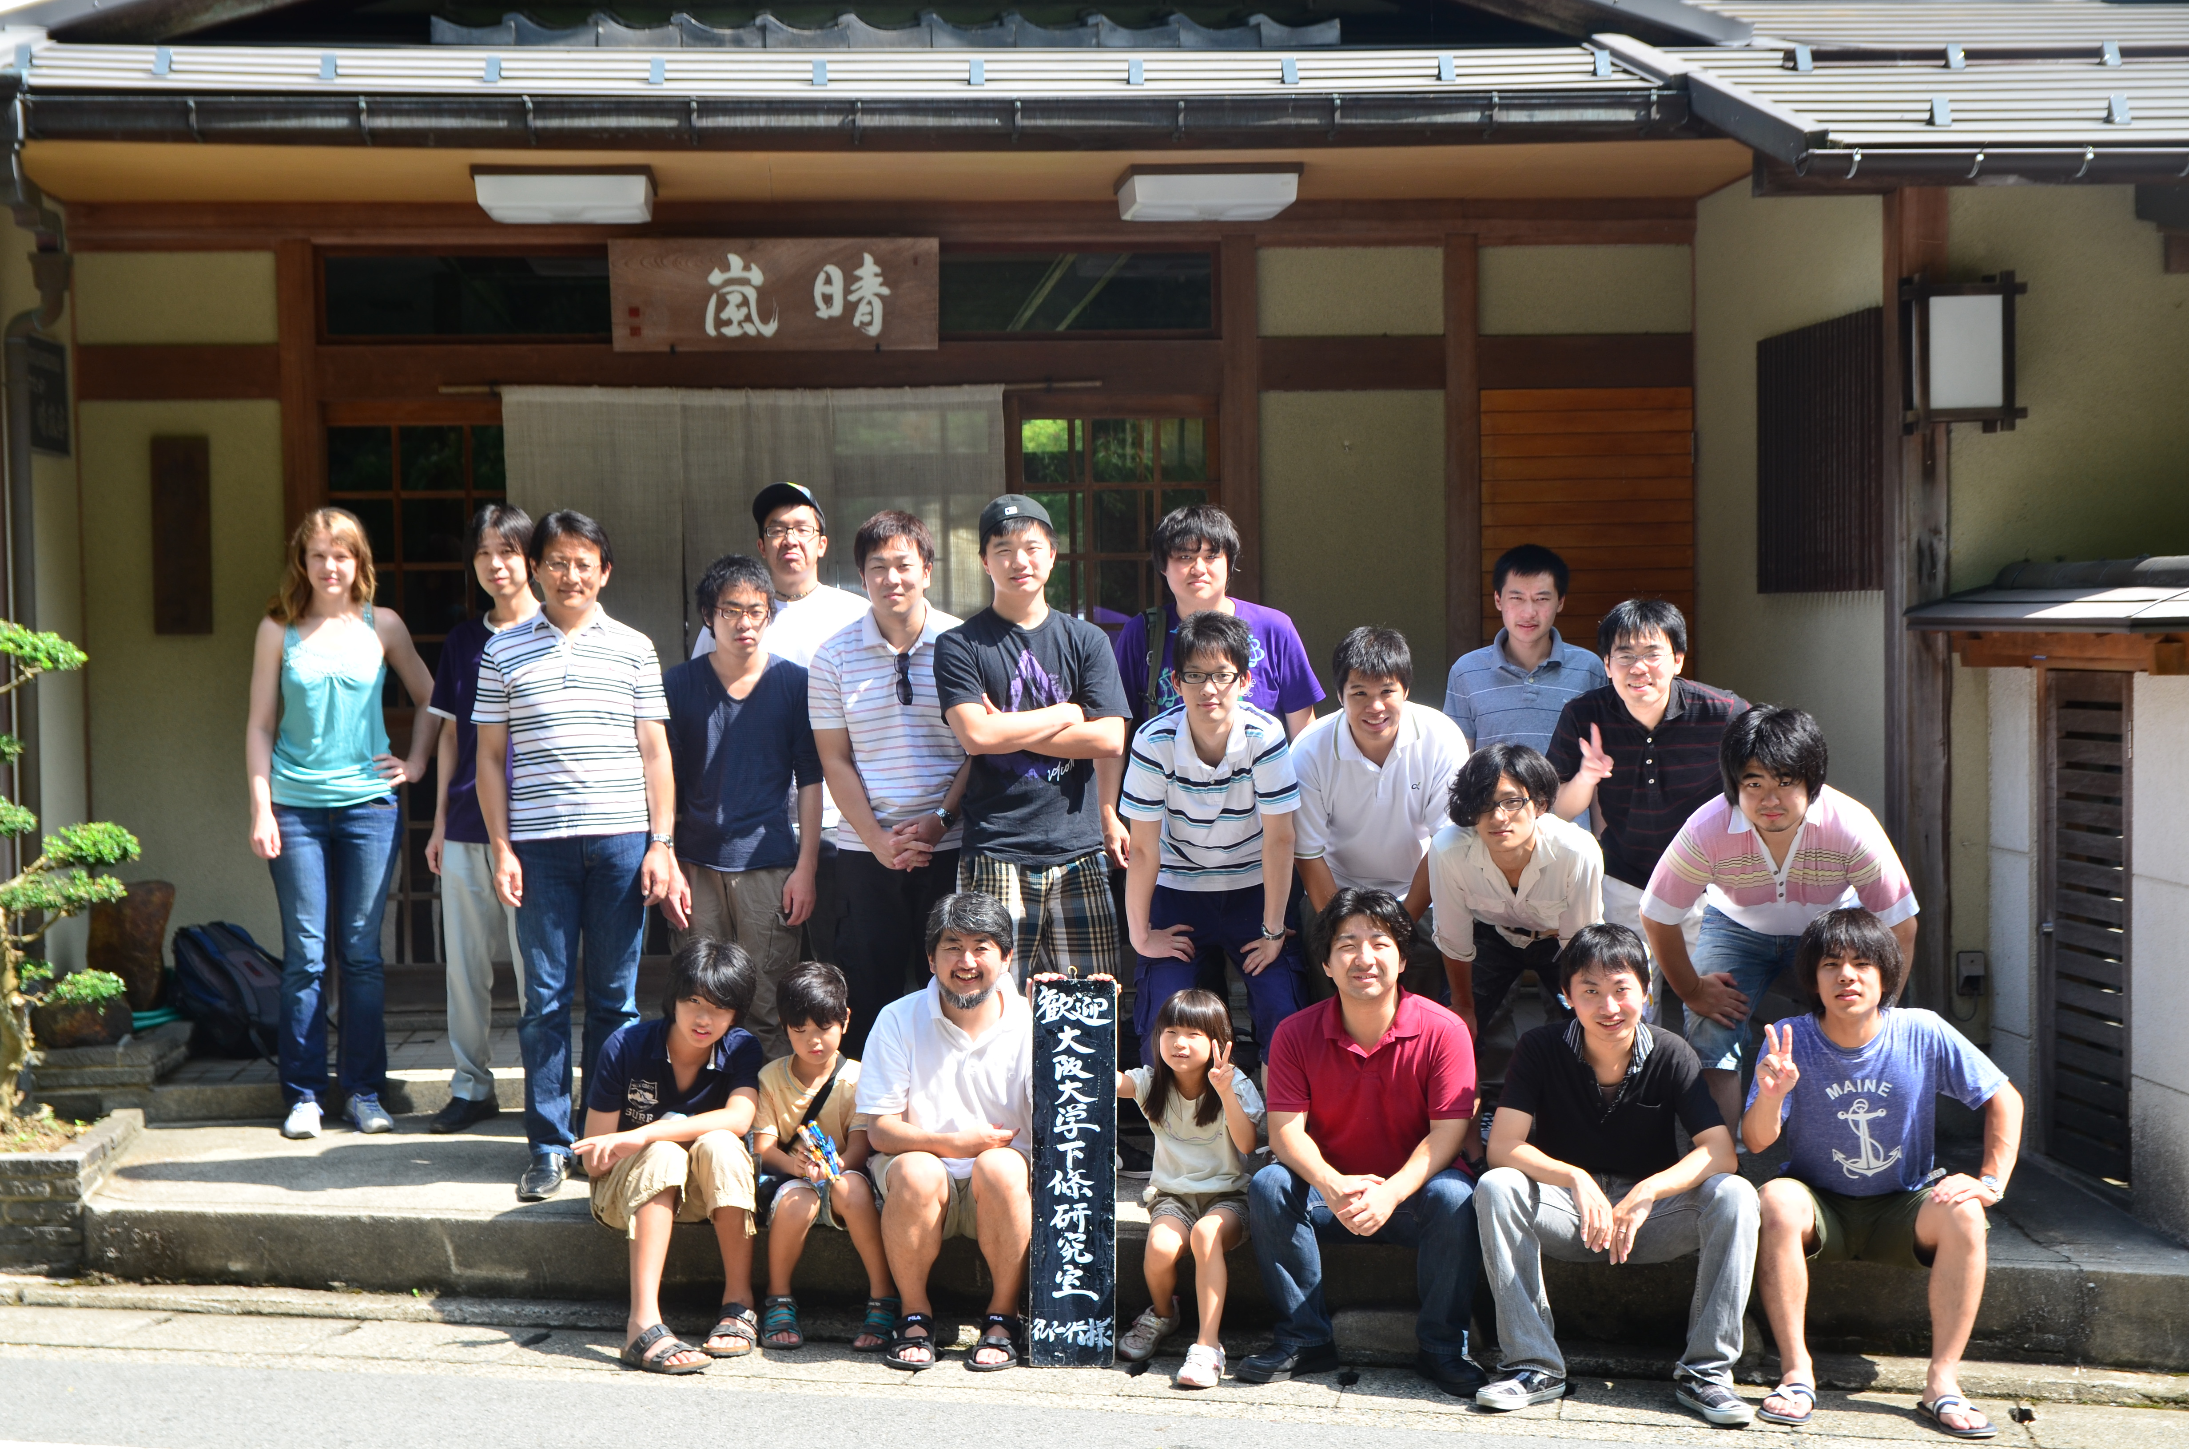
Thank You Very Much!

